Slide 1
Chapter 3
Growth of Functions
Sun-Yuan Hsieh
謝孫源 教授
成功大學資訊工程學系

Slide 2
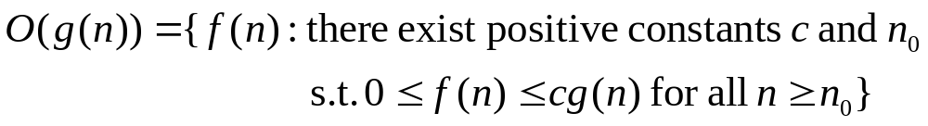
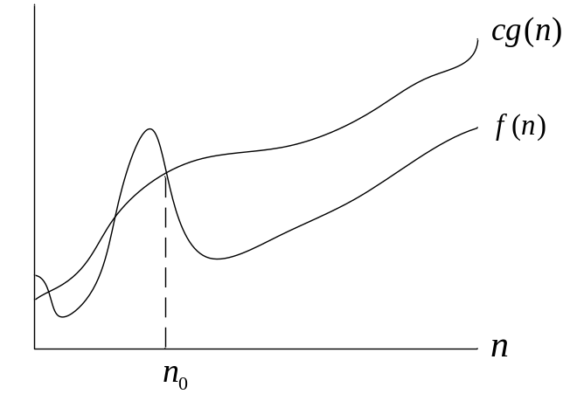
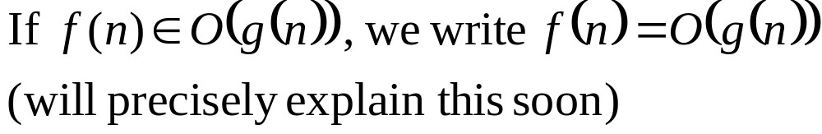
Asymptotic notation
g (n) is an asymptotic upper bound for f (n)

Slide 3
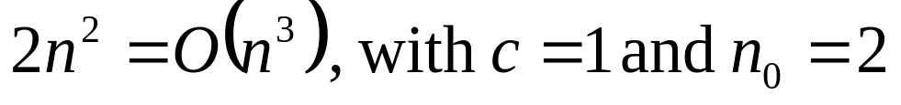
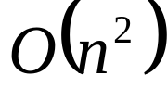
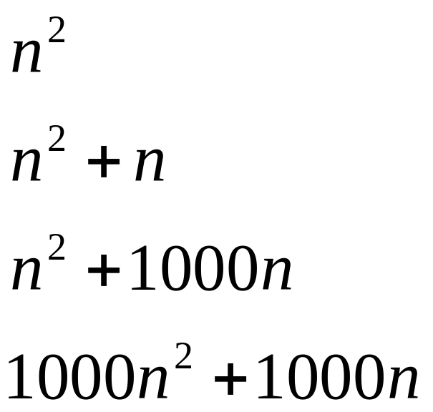
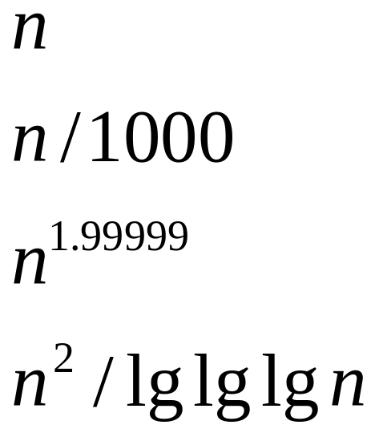

Asymptotic notation
O-notation
Example:
Examples of the functions in :

Slide 4
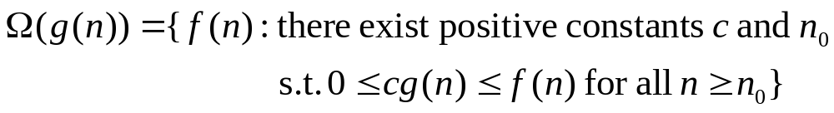
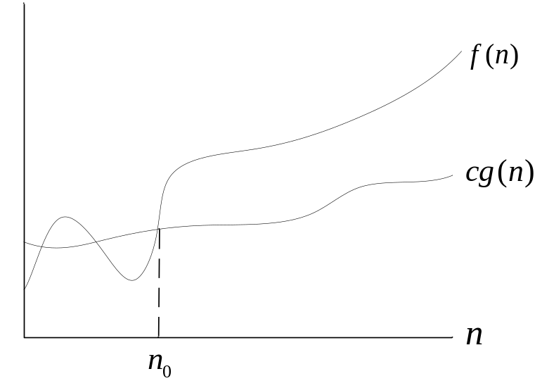
Asymptotic notation
g (n) is an asymptotic lower bound for f (n)

Slide 5
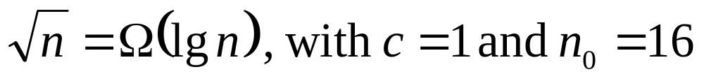
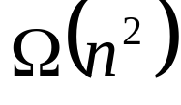
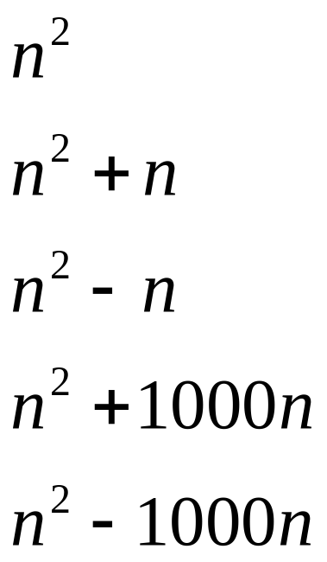
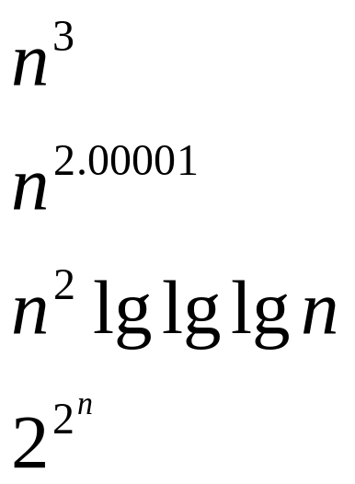
Ω-notation
Example:
Examples of the functions in :

Slide 6
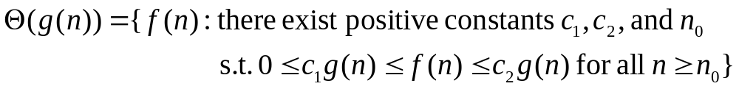
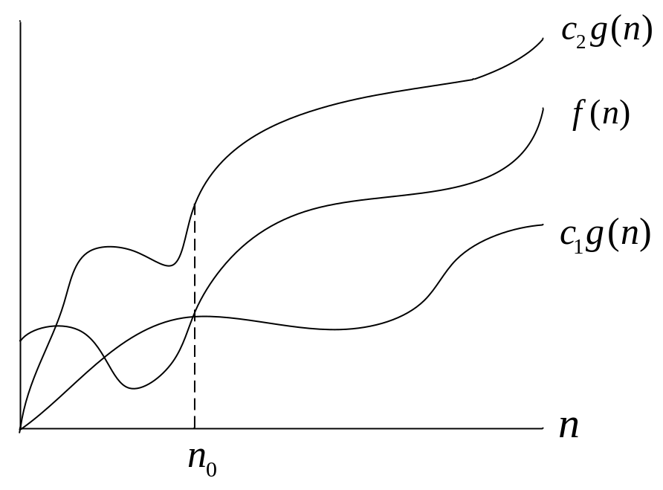
Asymptotic notation
g (n) is an asymptotic tight bound for f (n)

Slide 7
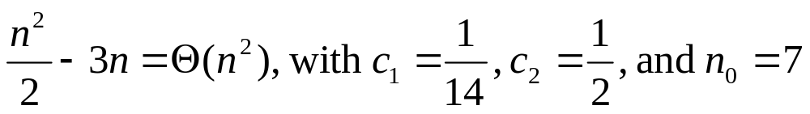
Asymptotic notation
Θ-notation
Example:
Theorem
Leading constants and low-order terms don’t matter.

Slide 8
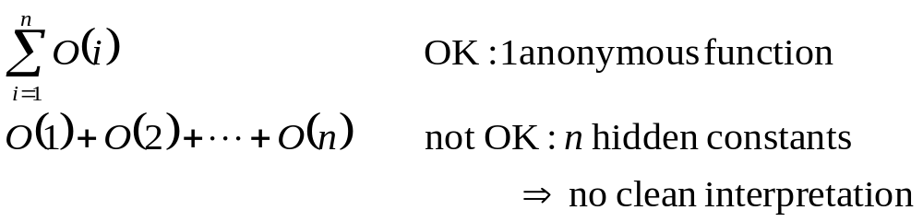
Asymptotic notation in equations
When on the right-hand side:
We interpret # of anonymous functions as = # of times the asymptotic notation appears:

Slide 9
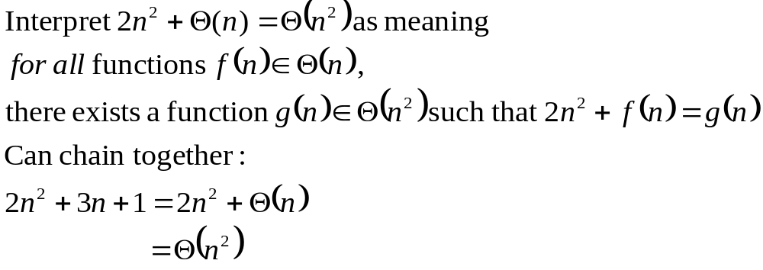
Asymptotic notation in equations
When on the left-hand side:
No matter how the anonymous functions are chosen on the left-hand side, there is a way to choose the anonymous functions on the right-hand side to make the equation valid.

Slide 10
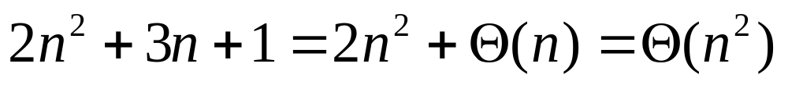
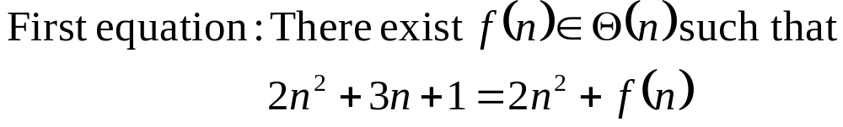
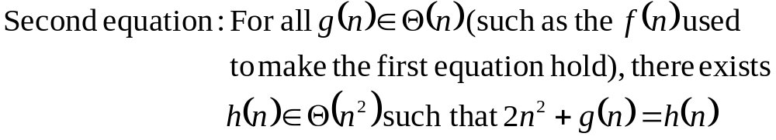
Asymptotic notation in equations
Interpretation

Slide 11
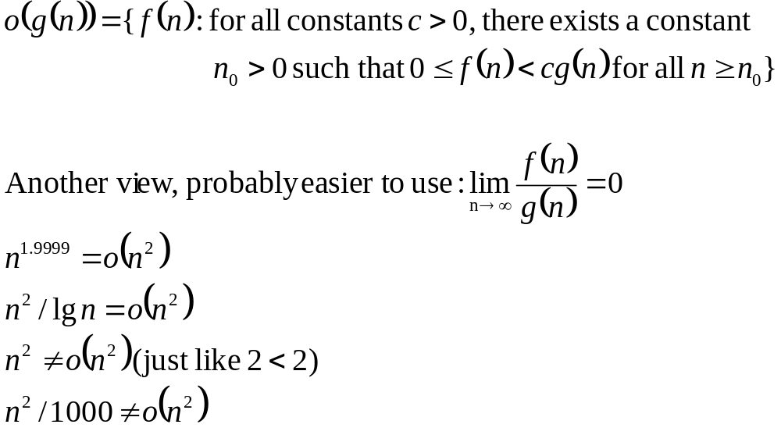
Asymptotic notation in equations
o -notation

Slide 12
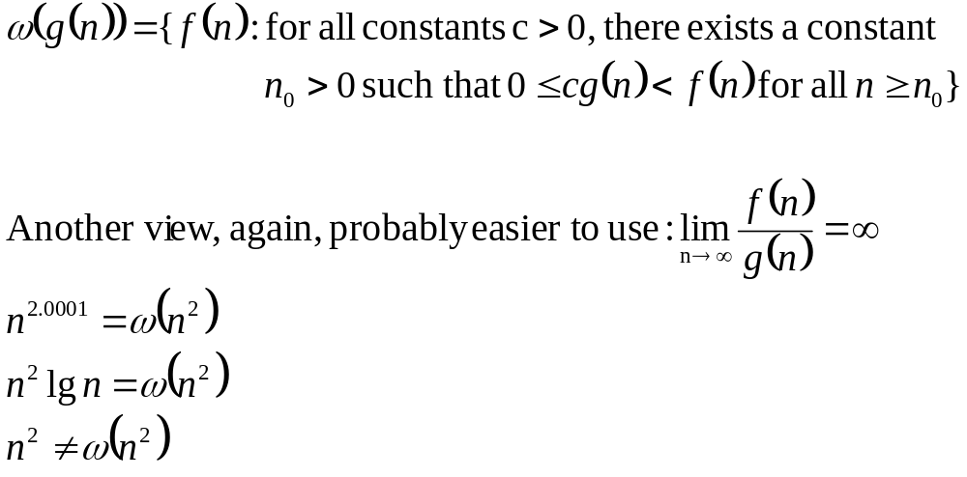
Asymptotic notation in equations
ω -notation

Slide 13
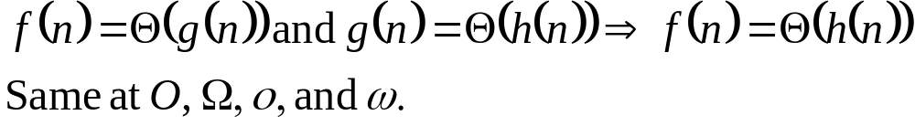
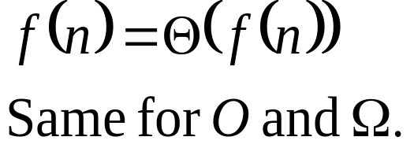

Comparisons of functions
Relational properties:
  Transitivity:
  Reflexivity:

Slide 14
Comparisons of functions
Relational properties:
  Symmetry:
  Transpose symmetry:

Slide 15
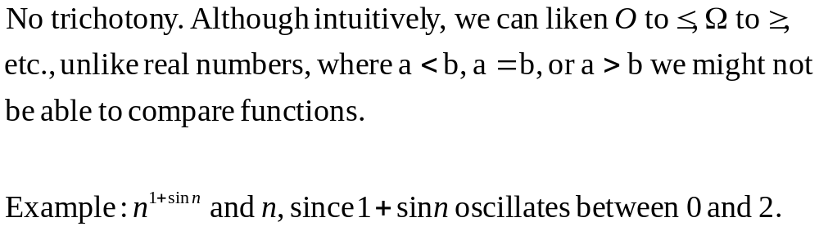
Comparisons:
f (n) is asymptotically smaller than g(n) if f (n) = o(g(n))
f (n) is asymptotically larger than g(n) if f (n) = ω(g(n))

Slide 16

Standard notations and common functions
Monotonicity
f (n) is monotonically increasing if m ≤ n f (m) ≤ f (n)
f (n) is monotonically decreasing if m ≤ n f (m) ≥ f (n)
f (n) is strictly increasing if m < n f (m) < f (n)
f (n) is strictly decreasing if m < n f (m) > f (n)

Slide 17
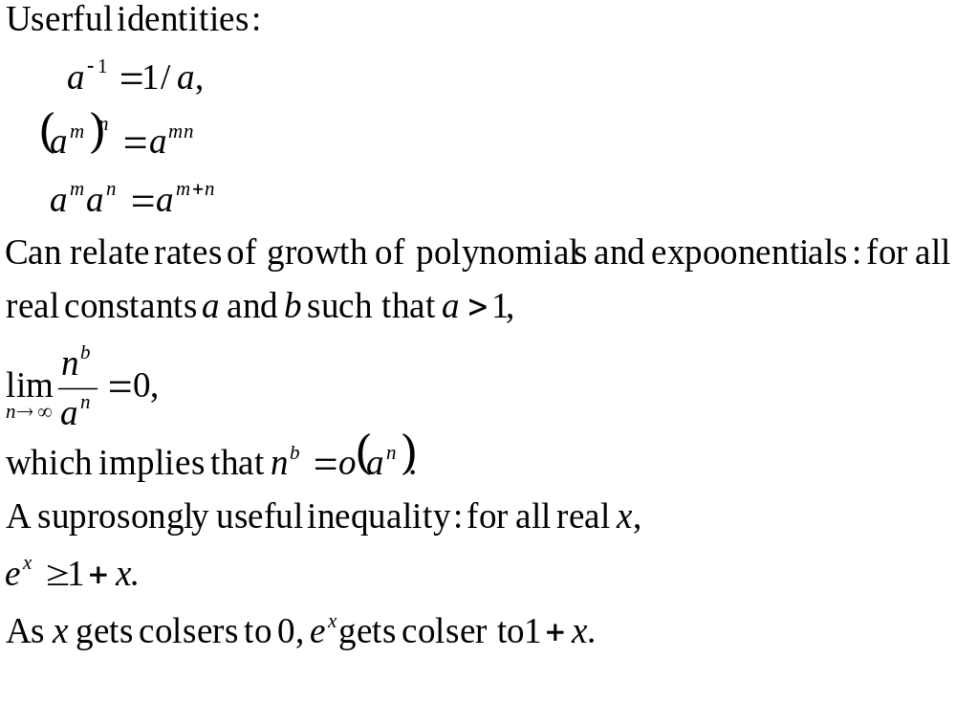
Exponentials
e = Euler's number ≈ 2.71828

Slide 18
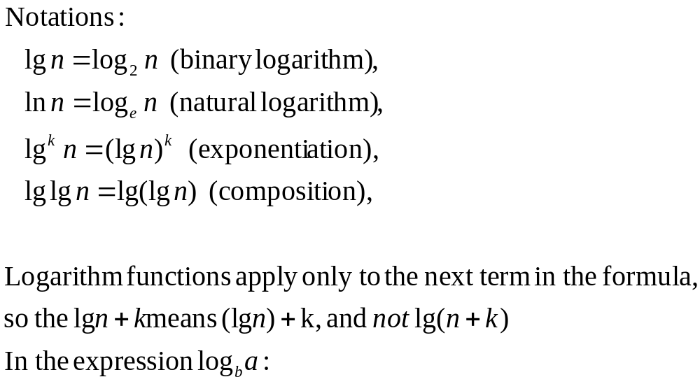
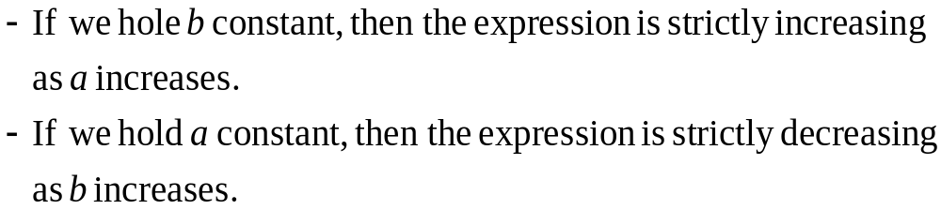
Logarithms(1)

Slide 19
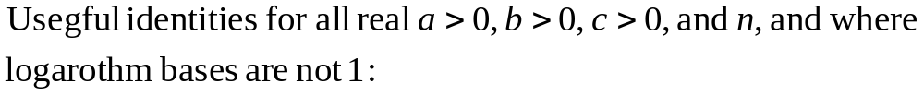
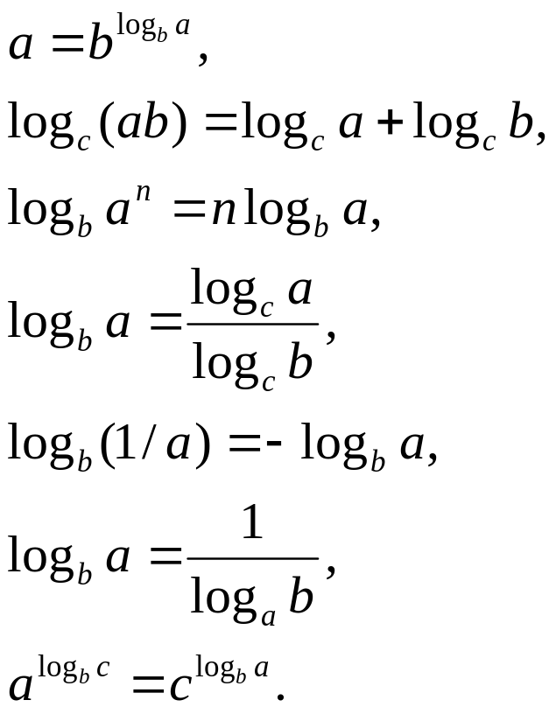
Logarithms(2)

Slide 20
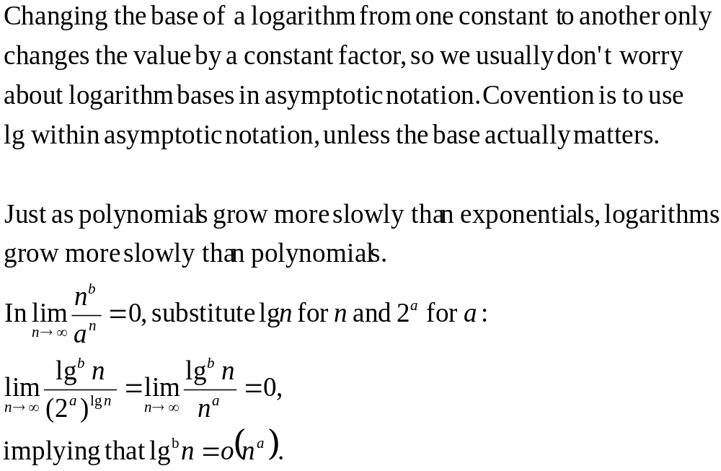
Logarithms(3)

Slide 21
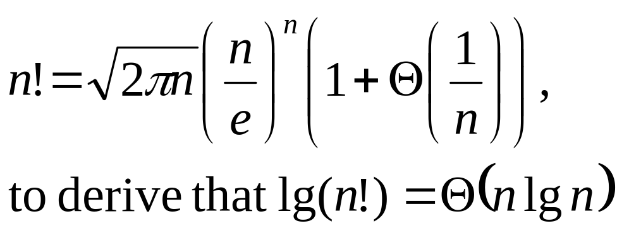
Factorials
Can use Stirling’s approximation,

Slide 22
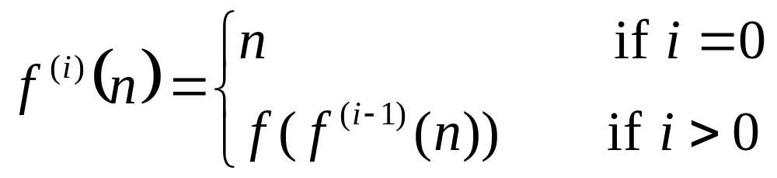

Functional iteration
  f^{(i)}(n) : f(n) iteratively applied i times to an initial value of n.
ex. If f(n) = 2n, then f^{(i)}(n) = 2^{i}n.

Slide 23
The iterated logarithm function
  lg*n = min{i ≥ 0 : lg^{(i)}n ≤ 1}
  ex. lg*2 = 1,
lg*4 = 2,
lg*16 = 3,
lg*65536 = 4,
lg*(2⁶⁵⁵³⁶) = 5.

Slide 24
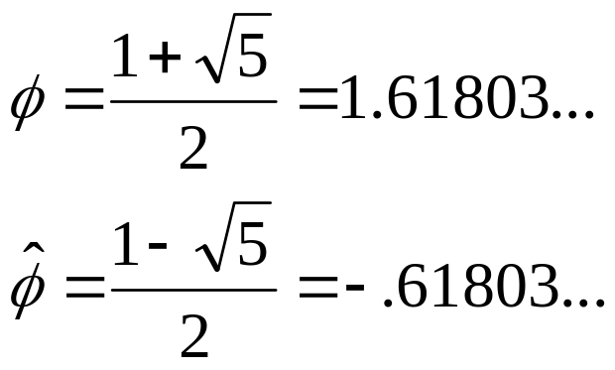
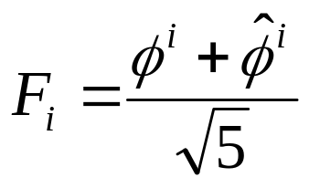
Fibonacci numbers
F₀ = 0,
F₁ = 1,
F_{i} = F_{i−1} + F_{i−2} for i ≥ 2.
golden ratio
⇒

